Slide 1
Software Testing
Module - 1
Testing Basics
Test Case Design
Levels of Testing

Slide 2
Software Testing
Software Testing is the process of checking if a software application works correctly and meets the set requirements. It involves running the software in different situations to find any mistakes, bugs, or missing features.
The main goals of software testing are:
Ensure Quality: Make sure the software works as expected and meets users' needs.
Find Defects: Spot and fix any problems before the software is launched.
Check Functionality: Confirm the software works correctly in different scenarios.
Improve Performance: Ensure the software runs smoothly under normal use.
Software Testing is a crucial step in developing software. It helps confirm that the software is free of bugs, meets the design and technical standards, and fulfills user requirements effectively.

Slide 3
Software Testing
Basic steps in Software Testing:
Requirement Analysis: Understanding the software's requirements to identify what needs to be tested.
Test Planning: Developing a test plan that outlines the strategy, scope, resources, and schedule of testing activities.
Test Case Design: Creating detailed test cases based on the requirements and planning.
Test Environment Setup: Setting up the hardware, software, and network configurations needed for testing.
Test Execution: Running the test cases on the software to identify defects.
Defect Reporting: Logging and tracking defects identified during test execution.
Retesting & Regression Testing: Fixing the reported defects, retesting to verify the fixes, and performing regression testing to ensure no new issues have been introduced.
Test Closure: Finalizing the testing process, documenting findings, and closing the testing phase.

Slide 4
Software Testing
Importance:
Ensures reliability and performance.
Helps identify defects early, reducing costs.
Increases user satisfaction by delivering quality software.
Goals:
Identify and fix defects.
Validate and verify the software.
Ensure compliance with requirements.

Slide 5
Testing as an Engineering Activity
Importance of Testing as an Engineering Discipline (Key Points):
Ensures Quality: Verifies software meets requirements and identifies defects.
Improves Reliability: Ensures consistent, expected performance under various conditions.
Customer Satisfaction: Delivers functional software that meets user expectations.
Cost Efficiency: Early defect detection reduces expensive late fixes.
Compliance and Standards: Ensures software meets industry regulations.
Continuous Improvement: Supports iterative development and feedback for ongoing refinement.

Slide 6
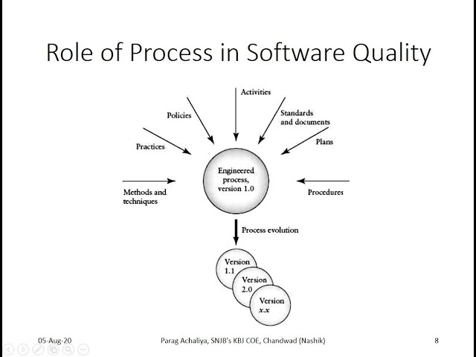
Role of Process in Software Quality
In software testing, processes ensure a structured approach, consistent execution, and thorough test coverage. They help plan tests, manage risks, maintain reproducibility, and improve efficiency. Well-defined processes also provide traceability, documentation, and continuous improvement, ultimately enhancing software quality and reducing defects.

Slide 7
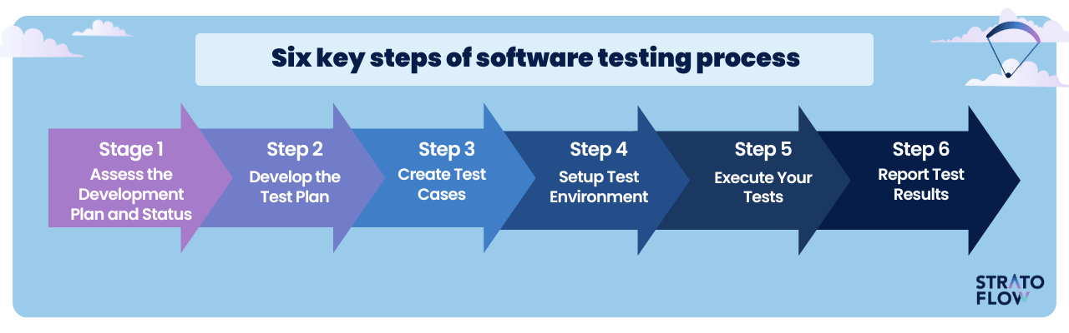
Testing as a Process

Slide 8
Testing as a Process
Assess the Development Plan and Status: Understand the project scope, development progress, and testing goals.
Develop the Test Plan: Strategize testing by defining scope, methods, tools, and resources.
Create Test Cases: Develop specific test cases detailing what, how, and expected results.
Setup Test Environment: Prepare hardware and software mimicking the production environment.
Execute Your Tests: Run the tests, observe behavior, and log defects if results deviate.
Report Test Results: Compile a report on testing, defects, and software quality to inform stakeholders.

Slide 9
Basic Definitions:
Error: An error is a discrepancy between the actual value of the output given by the software and the specified correct value of the output for that input.
Error refers to the difference between actual output and correct output.
Error also refer to human actions that result in software containing a defect or fault.
Errors can be:
(i) Syntax Error: It is a program statement that violates one or more rules of language in which it is written.
(ii) Logic Error: Deals with incorrect data fields, out of range terms invalid combinations.
Fault: Fault is a condition that causes a system to fail in performing required function. Fault is the basic reason of software malfunction.
We can often find faults without execution of code. They may be found through inspection, compiler diagnostics, design or code reviews or code reading.

Slide 10
Basic Definitions:
Bug: When developers make mistake in coding, we call them bugs.
Failure: Failure is the inability of the software to perform its required function, according to its specification. A failure occurs when fault executes. A failure is produced only when there is fault in the system.
Defect: A defect can occur both due to incorrect implementation of the code and due to unmet customer requirements or specifications.
It can include:
Code-related issues: Bugs or faults in the software code that cause incorrect behavior.
Requirement-related issues: When the software does not meet the specified or expected requirements of the customer, leading to a gap in functionality or performance.

Slide 11
Basic Definitions:
Test Plan: A test plan is a high-level document that outlines the strategy, objectives, scope, approach, and resources required for testing.
It includes:
Test objectives and scope
Testing approach (e.g., manual or automated)
Testing tools and environment details
Test deliverables
Roles and responsibilities
Schedules and timelines
The test plan serves as a roadmap for the entire testing process.

Slide 12
Basic Definitions:
Test Case: A test case is a detailed set of instructions used to verify a specific aspect of the software's functionality.
It includes:
Test case ID
Test scenario or functionality being tested
Input data
Expected results
Actual results
Pass/Fail status
Test cases are designed to check if a particular feature or function works as expected under specific conditions.

Slide 13
Basic Definitions:
Test Suite: The set of test cases is called a test suite.
The test suite contains multiple test cases related to a specific module or feature.
Example of Test Suite:
A Login Feature Test Suite could contain the following test cases:
Test Case 1: Valid login with correct username and password.
Test Case 2: Invalid login with incorrect username.
Test Case 3: Invalid login with incorrect password.
Test Case 4: Login attempt with empty fields.
Test Case 5: Login with special characters in username/password.

Slide 14
Basic Definitions:
Test Script: A test script is the detailed implementation of a test case in code, defining the steps and logic to execute the test automatically.
The most important points:
Automation: Reduces manual effort and speeds up the testing process.
Assertions: Verifies that the application behaves as expected, determining test success or failure.
Reusability: Allows test scripts to be reused in different test cycles and environments, saving time and effort.
Cross-Platform Support: Ensures that tests can be executed across multiple browsers and platforms, increasing test coverage.

Slide 15
Software Testing Principles
Principles of Software Testing:
Find Bugs – Testing shows defects.
Can't Test Everything – Complete testing is impossible.
Start Early – Test early in the development process.
Bug Hotspots – Bugs are concentrated in specific areas.
Update Tests – Repeating tests won’t find new bugs.
Adapt Testing – Testing depends on the project context.
Bug-Free ≠ Perfect (Absence of Error Fallacy) – No bugs doesn’t mean it meets all needs.

Slide 16
The Tester’s Role in a Software Development Organization
Responsibilities of a Tester:
Test Planning: Define test strategy, scope, and objectives. Prepare test plans, test cases, and test suites.
Test Design and Execution: Create test scenarios, execute manual or automated tests, and validate software functionality.
Defect Identification and Reporting: Detect defects, document issues, and track them for resolution.
Test Reporting: Provide detailed reports on test results, bug severity, and overall product quality.
Regression Testing: Ensure new changes don't affect existing functionality.
Test Maintenance: Update tests based on changes in requirements or functionality.

Slide 17
The Tester’s Role in a Software Development Organization
Collaboration of Tester with developers, with product owners, with designers, and stakeholders:
With Developers: Discuss defects, verify fixes, and understand the code changes affecting testing.
With Product Owners: Ensure testing aligns with user stories and business requirements.
With Designers: Validate that UI/UX design meets expectations and behaves correctly.
With Stakeholders: Provide testing updates, timelines, and quality assessments.

Slide 18
The Tester’s Role in a Software Development Organization
Skills Used By Testers:
Analytical Thinking: Identify edge cases and potential issues.
Attention to Detail: Spot discrepancies in requirements and behavior.
Communication: Report issues and collaborate with teams effectively.
Problem-Solving: Diagnose issues and suggest solutions.
Technical Knowledge: Understanding of programming and databases for debugging.

Slide 19
The Tester’s Role in a Software Development Organization
Tools Used By Testers:
Manual Testing Tools: JIRA, TestRail, Quality Center.
Automation Tools: Selenium, QTP, Appium.
Performance Testing Tools: JMeter, LoadRunner.
Bug Tracking Tools: JIRA, Bugzilla.
CI/CD Tools: Jenkins, GitLab CI.
API Testing Tools: Postman, SoapUI.

Slide 20
Origins of Defects: 1. Defects Classes 2. The Defect Repository and Test Design 3. Defect Examples 4. Developer/Tester Support for Developing a Defect Repository

Slide 21
Origins of Defects:
The most important points for the origin of defects:
Requirements Defects: Misunderstandings or unclear requirements.
Design Defects: Flaws in system architecture or design decisions.
Coding Defects: Errors made during development, including logic and human mistakes.
Testing Defects: Insufficient or poor test coverage, missing critical issues.
User Defects: Incorrect usage or unmet user expectations.
Management and Process Defects: Poor communication, planning, or process management.
External Dependencies: Failures from third-party libraries or services.
Legacy System Defects: Integration issues with older systems.

Slide 22
Defects Classes:
Defect Classes:
Functional Defects: Failures to meet functional requirements (e.g., incorrect calculations).
Non-functional Defects: Issues with performance, security, or usability (e.g., slow response, security flaws).
Interface Defects: Problems with communication between components or systems (e.g., API errors).
Boundary Defects: Errors at the limits of input or output values (e.g., exceeding max input limits).
Configuration Defects: Issues from incorrect system setup or environment mismatches (e.g., wrong settings).

Slide 23
Defects Classes:
Defect Classes:
Performance Defects: Problems with system speed or scalability (e.g., long load times).
Usability Defects: Poor user experience (e.g., confusing UI or navigation).
Security Defects: Vulnerabilities exposing the system to attacks (e.g., weak encryption).
Regression Defects: Breakage of previously working functionality due to new changes.
Data Defects: Incorrect or missing data (e.g., database errors).

Slide 24
The Defect Repository and Test Design:
Defect Repository: A defect repository is a centralized system where all defects identified during testing are documented and tracked. It contains detailed information about each defect, helping teams understand the issues and prioritize fixes.
Key features include:
Defect ID: Unique identifier for each defect.
Defect Description: Detailed explanation of the issue.
Severity and Priority: Classification of the defect’s impact and urgency.
Status: Current state (open, closed, in progress).
Root Cause: Underlying cause of the defect, if identified.
The repository allows for effective defect tracking, reporting, and analysis.

Slide 25
The Defect Repository and Test Design:
Test Design: Test design involves creating test cases that ensure the software works as expected.
The defect repository plays a key role in this process by:
Identifying Areas of Risk: Analyzing past defects to focus testing efforts on high-risk areas.
Guiding Test Case Creation: Past defects provide insights into common failure points, helping in the creation of new test cases or enhancing existing ones.
Supporting Regression Testing: When defects are fixed, the repository helps ensure that related areas are tested to prevent regression.
By analyzing defects, testers can design more targeted and effective test cases, improving test coverage and reducing future defects. The defect repository informs test design, helping to improve the overall quality of the software.

Slide 26
Defect Examples :
Here are some examples of defects that may occur in software:
1. Functional Defects: Example: A shopping cart application doesn't update the total price after an item is added.
2. Performance Defects: Example: A website takes too long to load when accessed by multiple users simultaneously.
3. Security Defects: Example: A login page is vulnerable to SQL injection, allowing unauthorized access.
4. Usability Defects: Example: A form’s submit button is placed in an obscure location, making it difficult for users to find.
5. Interface Defects: Example: A user clicks a button in the app, but no action is triggered due to a broken API integration.

Slide 27
Defect Examples :
Here are some examples of defects that may occur in software:
6. Boundary Defects: Example: A form fails to accept valid input values like dates that fall on the edge of a defined range (e.g., 01/01/2025).
7. Data Defects: Example: A report generates incorrect data, such as showing wrong sales totals due to data corruption.
8. Regression Defects: Example: A previously working feature, such as a search function, stops working after a new software update.

Slide 28
Developer/Tester Support for Developing a Defect Repository:
By working together, developers and testers ensure that the defect repository is a valuable resource for improving software quality. Clear documentation, regular updates, and collaborative communication make the defect repository an essential tool in identifying and addressing software issues efficiently.
Clear Communication: Testers document defects; developers provide feedback.
Consistent Categorization: Agree on defect types and priority.
Root Cause Analysis: Collaborate to prevent recurring defects.
Defect Management: Regular updates on defect status.
Feedback Loops: Ongoing feedback to improve defect handling.
Collaboration Tools: Use tools like JIRA for tracking.
Defect Prevention: Improve practices based on defect patterns.
Post-Release Review: Review defects to improve processes.

